Slide 1

CSE499B Project Update
Group: 01
Group Members:
1. Sadman Chowdhury Siam - 1711172042
2. Abrar Faisal
3. Niazi Mahrab
Date – 03-Dec-2020
Notes:
Greeting sir. Hope You are doing well.
I am sadman and along with me is Abrar and Niazi. We will be giving a brief presentation on our project.
In this project we tried to implement a great system based on Compurter Vision and Deep learning.
And the name of our project is Generating automated student review system with AI.
So now I will give you a high level view of our project.
So this is our complete pipeline of the project. First we have applied computer vision over the image to extract faces and then we have pre processed the extracted image to feed in the deep learning model.
The model is designed to predict emotion from the images. These emotion results will later be used as scores for generating reviews.
Lets see how the review system works.
For the system to work we, have to collect continuous pictures of students in a period of specific time frame..
Lets see for a single image and how we can generate the reviews from that image.
Here you can see the image and we will use computer vision to extract faces from the image.
Then we have taken each of the images and used them in our model one by one.
We have fed the extracted input image to our neural network model to predict facial expression.
Here we can see the model is predicting the face as happy.
Now lets try to understand what going on behind this model. So this is the architecture that we have designed to train the model.
The architecture could be thought of as a smaller version of the VGG model. We have tried to design each of the block to be like VGG, but kept the smaller as our dataset size was 48 by 48 pixels.
Here are the parameters we have used during training.
Based on the expression predicted from the model our algorithm will generate a score to calculate the review. We have assigned the following scores for each of the expressions.
This is the algorithm that we have designed to generate review.
We will continue the process for all the other images.
Than we will average the score and generate the review for that particular time frame.
For the final review we will take the review generated from all the timeframe and average them out.
Now abrar faisal will continue with the necessary technologies that we used for our approach.
Hello sir. Our System is developed based on Artificial Intelligence.
We have used computer vision technique to detect faces. Opencv’s DNN module provides a face detector model that can detact faces with high accuracy. We have used that in our project.
Than we have used convolutional neural network to train our model. Cnn are really powerfull technique to work with image data.
It uses thousands of kernel to extract spatial features from images.
With the trained CNN we have predicted facial expressions.
Now Niazi will continue on the application of the system.
Greetings Sir.
So far my team mates have described the theory of our system. We have mentioned the methodologies in details in our paper.
Here is the result of our training. You can see in the graph that our model accuracy improved with time and attained almost 70% accuracy.
But as there are lots of pretrained model for detecting emotions so we mainly focused on the application part.
We have designed our algorithm and used technologies that are easy to implement and simple
Any one can implement the system based on our designed algorithm to generate review.
It is possible to generate real time student review by using IOT devices with built in cameras and cloud technologies with our described methodology.
The same idea can also be used for restaurant review generation, Movie Review generation from a cinema hall and many more.
The possibilities are endless.
Thank you.

Slide 2

Project Name
Automated Student Review Generation With CNN and Computer Vision

Slide 3
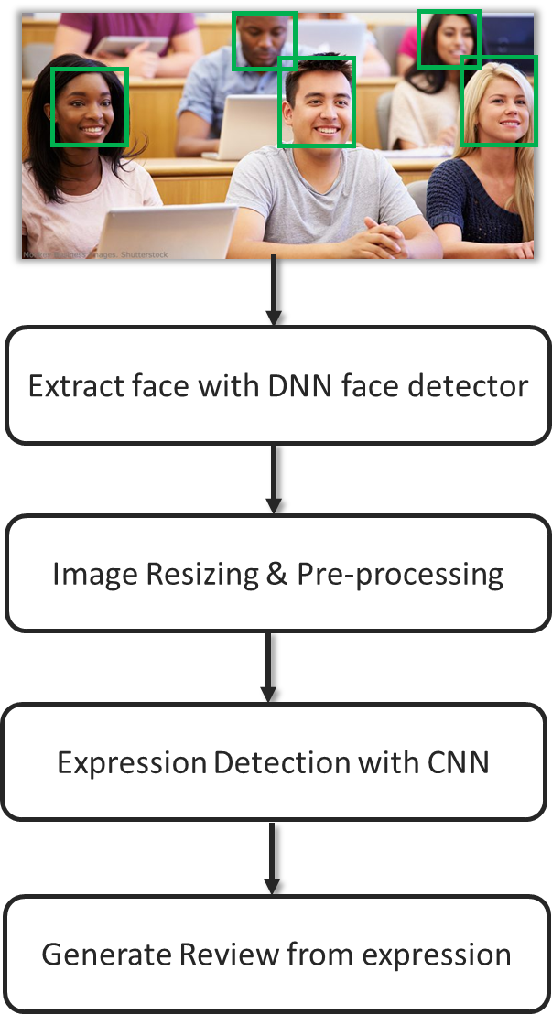
Project Overview

Slide 4
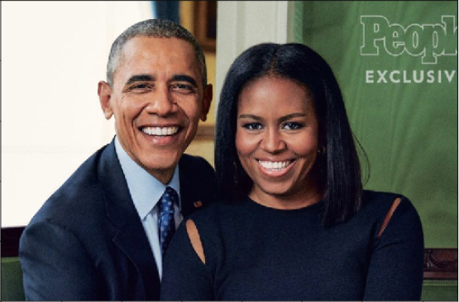
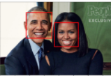
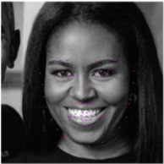
Facial Emotion Detection Pipeline
Computer Vision
Extract Faces &
Preprocess image
Happy
Deep Learning Model
224 x 224
Happy
224 x 224

Slide 5
System Overview
0
Time Frame

Slide 6

System Overview

Slide 7
System Overview
Happy 😊
Input
Prediction
Deep Learning Model

Slide 8
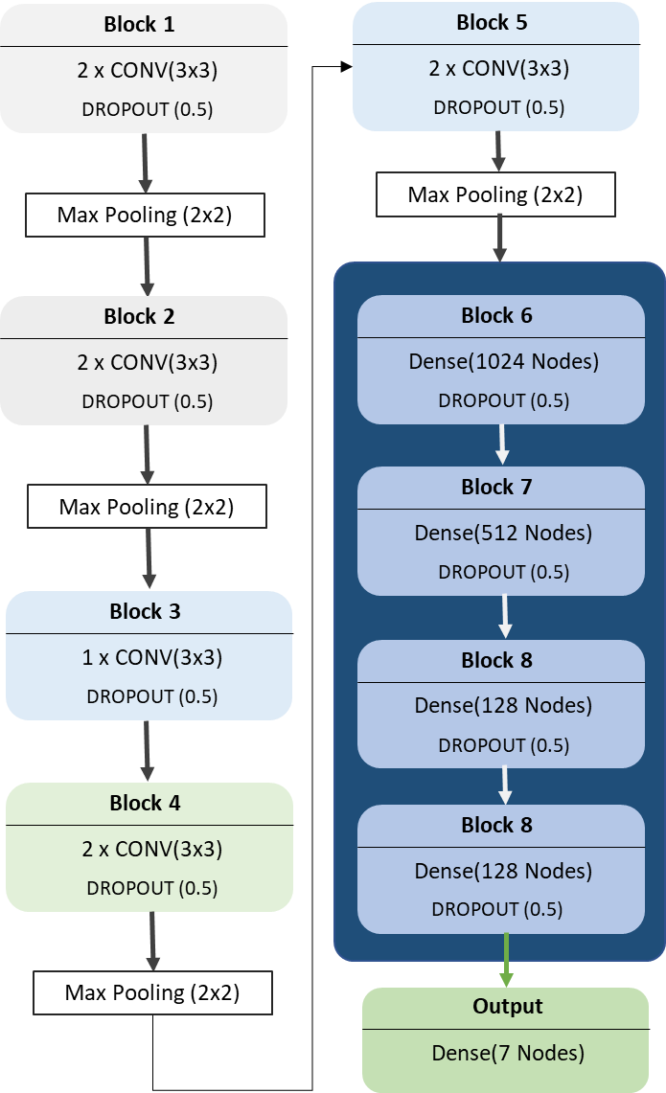
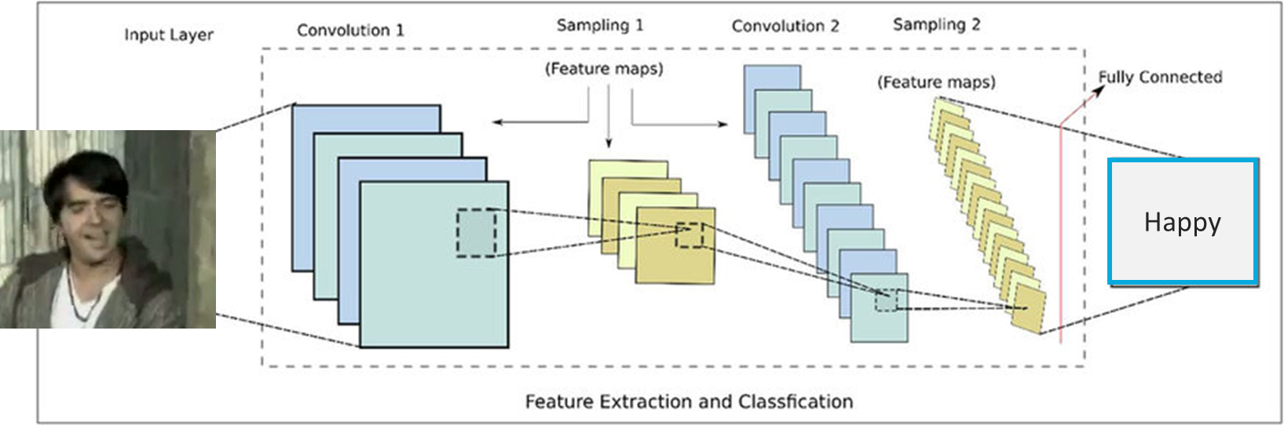
Architecture Design

Slide 9
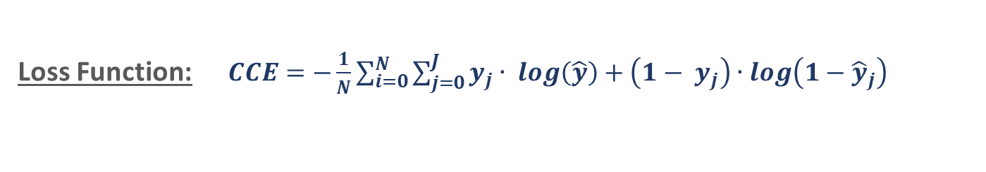
Model Training
Loss Function:$CCE=−\frac{1}{N}\sum_{i=0}^{N}{\sum_{j=0}^{J}{y_{j}∙ \log\left(\hat{y}\right)+\left(1− y_{j}\right)∙\log\left(1−{\hat{y}}_{j}\right)}}$
Optimizer Function:$Adam Optimezer$
Learning Rate:$0.001$

Slide 10
System Overview
Emotion | Score
Happy | 1
Fear | 0.7
Neutral | 0.6
Surprise | 0.5
Sad | 0.4
Angry | 0.25
Disgust | 0

Slide 11
Algorithm
Generating Review:

Slide 12
System Overview
For a particular time frame:
∑ (Review_Score)
Average Score =
Face_Count

Slide 13
System Overview
Final Score:
∑ (Average_Scores)
Score =
Number_of_time_frame

Slide 14
Technologies Used

Slide 15

Technology Used
Computer Vision
Face Detection using OpenCV's DNN module

Slide 16
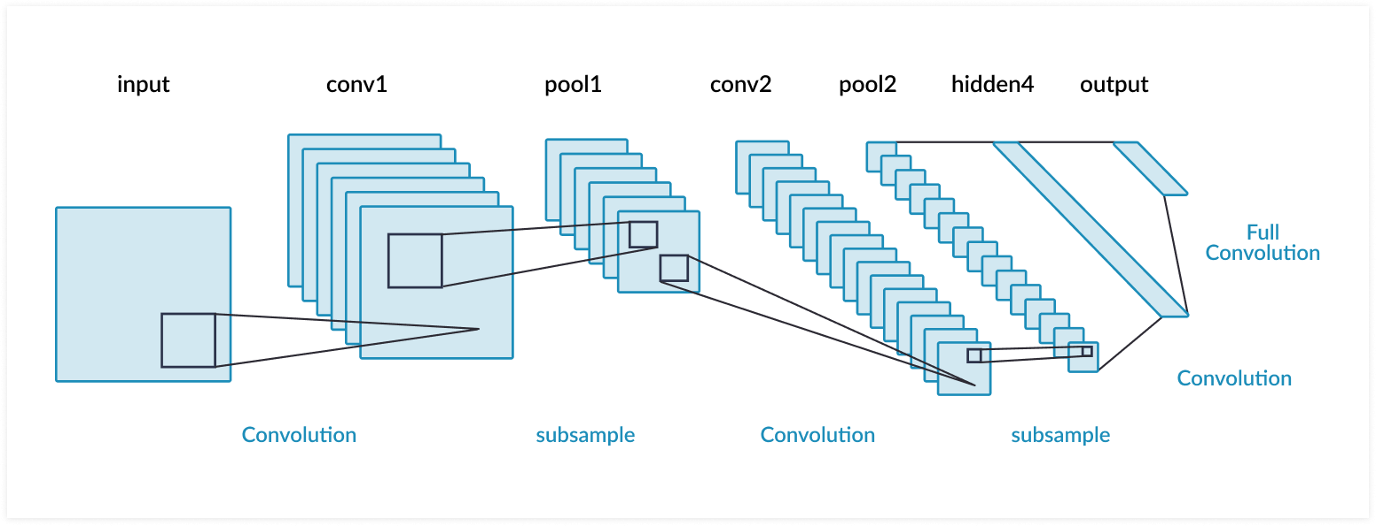
Technology Used
CNN
Feature Extraction & Prediction

Slide 17
Application & Result

Slide 18
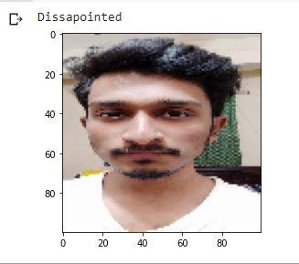
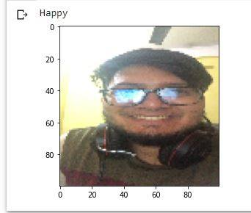
Result

Slide 19
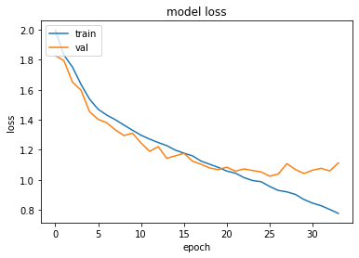
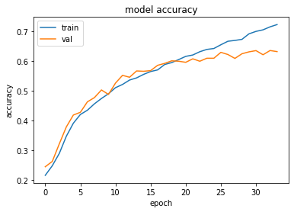
Result

Slide 20


Application
Simple Neural Network Model
Easily Implementable
Extending the idea
Connecting with IOT Devices
Real Time review generation
- Restaurant, Movie etc

Slide 21
Thank You

